Slide 1

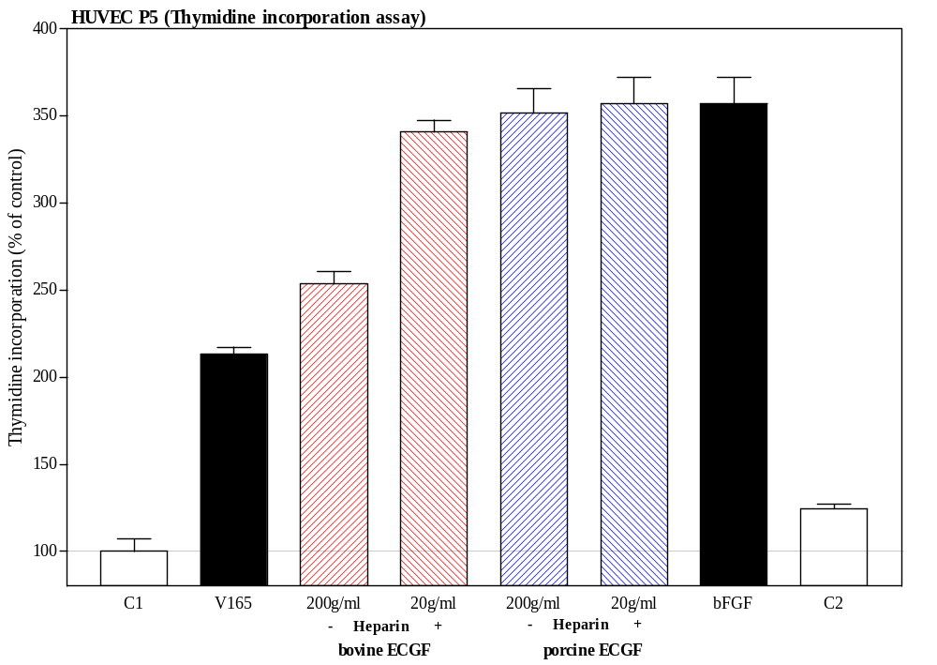
ReliaTech GmbH
Endothelial Cell Growth Factor (ECGF)
Primary human endothelial cells are very important tools for angiogenesis and lymphangiogenesis research. Endothelial cells from several human tissues, e.g. umbilical vein (HUVEC) or dermal skin can be established as primary cultures by traditional methods. The serial propagation of these cells has proved to be difficult. The long-term propagation of these cells in vitro can be achieved with an extract prepared from bovine brain. For this bovine brain was homogenized by use of a Waring blender (1). The homogenate was stirred for 2 hours at 4°C and then centrifuged at 13.800g for 40min at 4°C. The supernatant was recovered and dialysed against 0.1M NaCl/10mM Tris-Cl, pH 7.0. Then 0.5% streptomycin sulphate (removal of soluble lipids) was added, the homogenate stirred for at least 1h at 4°C and centrifuged again. The supernatant was recovered and dialyzed against PBS. The result was named “Endothelial Cell Growth Factor” (ECGF) although it is still a crude extract. However, the main active component seems to be basic FGF (fibroblast growth factor, FGF-2) which is a very strong mitogen for endothelial cells in culture.
The introduction of a fibronectin or collagen matrix to the cell culture system allows to cultivate endothelial cells at clonal densities. The use of human fibronectin in conjunction with ECGF and FCS (fetal calf serum) supplemented media allows the long-term serial propagation of human endothelial cells (20-60 cumulative population doublings) (2-7). With ECGF, the FCS requirement can be reduced (2, 3). Heparin potentiates the mitogenic activity of crude preparations of ECGF (7). ECGF (culture grade) has also been reported to eliminate the need for feeder cells in the clonal growth of hybridomas and other cell types (8, 9).
http://www.reliatech.de / info@reliatech.de

Slide 2
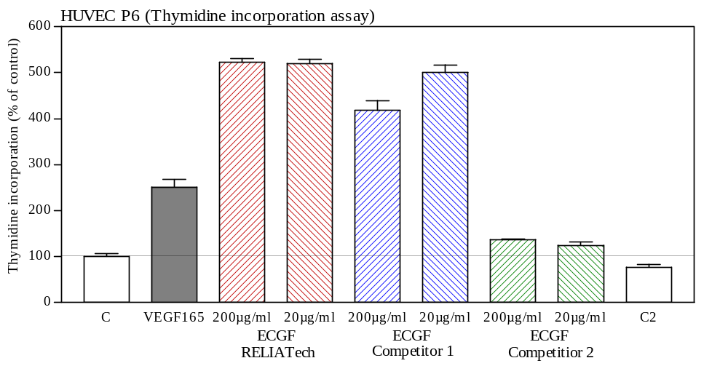
ReliaTech GmbH
References:
(1) Maciag T et al. (1979) Proc Natl Acad Sci USA 76, 5674 (2) Maciag T, Weinstein R (1984) In: Cell Culture Methods for Molecular and Cell Biology, Vol. 1 (Barnes DW, Sirbasku DA, Sato GH, eds.) Alan R. Liss, Inc., New York, pp. 195 (3) Maciag T, Weinstein R (1983) In: Hormonally Defined Media (Fischer G & Wieser RJ, eds.) Springer Verlag, Berlin, Heidelberg, New York, Tokyo, pp. 68 (4) Gordon PB et al. (1983) In Vitro 19,661 (5) Glassberg, M. K. et al. (1982) In Vitro 18,859 (6) Fry G et al. (1984) Artheriosclerosis 4, 4 (7) Thornton SC et al. (1983) Science 222, 623 (8) Pintus C et al. (1983) J Immunol Meth 61, 195; 9. Ransom JH (1986) Methods Enzymol 121, 293
http://www.reliatech.de / orders@reliatech.de

